Slide 1

Airbnb Price Predictions – 03/25/21
Kapil Pundhir, Hillary Mandich, Cecilia Leung, Amaris Hassan, Caitlan Beachey

Slide 2


Airbnb Pricing Background
Airbnb hosts in New York face lots of competition with approx. 37, 000 active listings
Currently there are no free services which help hosts price their properties.
Challenging task for owner to determine a hosting price that is both affordable and profitable
Guests have limited knowledge of property prices in New York and can also benefit from understanding the pricing dynamics of the Airbnb marketplace
Notes:
-Challenge: price too high and no one will book. Price too low and you’ll be missing out on a lot of potential income.
-Paid third party pricing software is available, but generally you are required to put in your own expected average nightly price (‘base price’), and the algorithm will vary the daily price around that base price on each day depending on day of the week, seasonality, how far away the date is, and other factors.

Slide 3
Objective
Accurately predict the optimal price for Airbnb properties in NYC according to their listing features and seasonal availability
Analyze 36923 active listings using attributes such as location, room type, amenities, and rating to create the model
Aim to help both guest and host understand whether the current listing price is worthy and the best time to book/make a room available on Airbnb

Slide 4
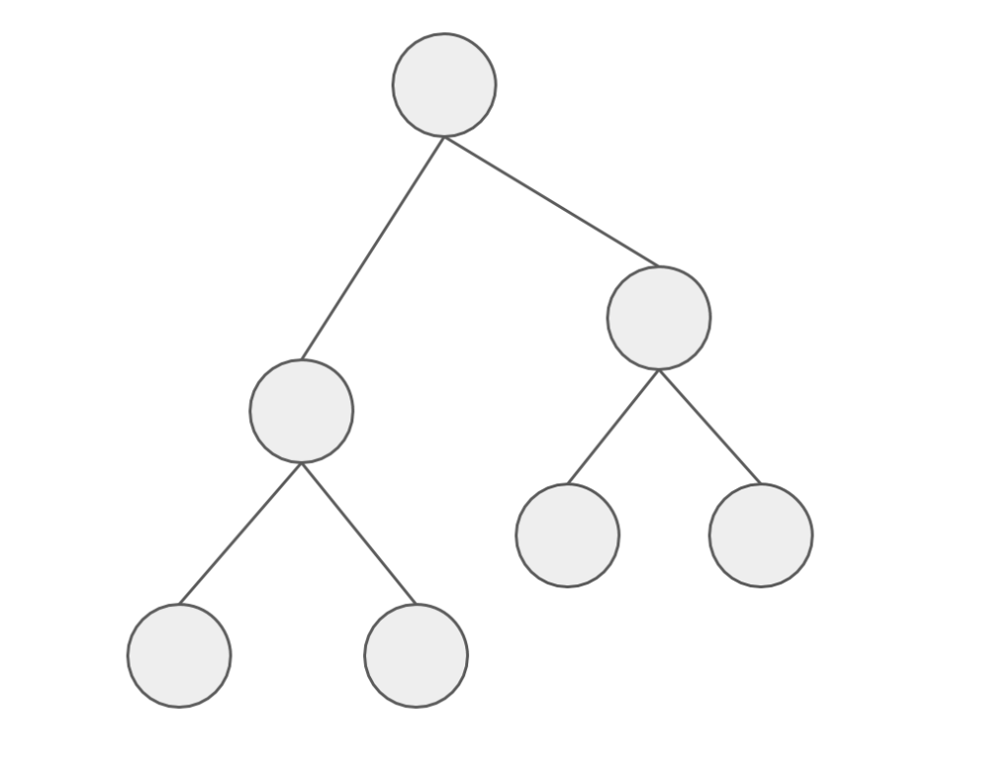
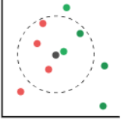
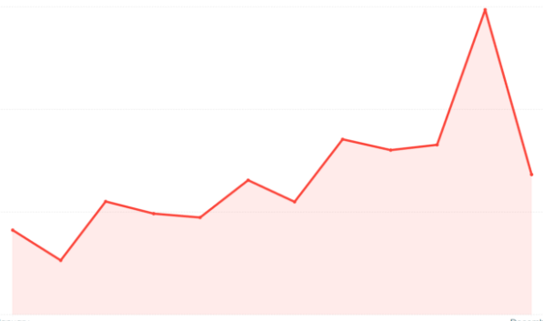
Price Predictor Models
Random Forest
LGBM
KNN
Facebook Prophet
Notes:
To build an Airbnb Price Predictor App, we used the Random Forest & LGBM Regressor methods to determine which features are important when pricing an Airbnb unit.
Then we used the KNN Regressor Model to see how the effectiveness of pricing a unit close by.
Finally, we used the Facebook Prophet Model to identify price trends at different times of the year.

Slide 5

Model Findings
Slight upward trend in the future.
Location is a key factor that segregates the rates from one area to another.
Low-Moderate clustering impact in predicting prices based on local average of a specific area.
Room Type and Accommodation Features are major factors that determine the price.
Seasonality and Trends have a big impact on how to price your listings.
Amenities are only nice-to-have features that have a slight impact in your Airbnb listings.
Notes:
Here are some of the key findings after running the model.
The predictor model shows there will be a slight price increase for 2022-2023.
Centrally located listings and reputable neighbourhoods usually sets the rates apart from one area to anther.
However, the host shouldn’t just look at the location and set the average price for that specific area. There are other important factors that the host should look at.
This includes the size of the unit where if the hosts provide more bedrooms and bathrooms, the listing price will increase.
Timing is important as the rates can fluctuate at different times of the year. Charging more on peak seasons, public holidays, long and regular weekends can help the hosts maximize their profits.
6) Having more amenities in your units may add a bit value in your unit. But it is not the first thing customers look into when booking an Airbnb

Slide 6
Dashboard

Slide 7
Project process
Notes:
Now we will explain hwo we get the final resutls

Slide 8
Changes in ETL Process
EXISTING
NEW
Listings Masters
Borough ID
Neighbourhood ID
Room Type ID
Yearly Rates
Monthly Rates
Day of Week Rates
Predicted Rates
Notes:
We already have information on the listings details with the yearly rates in our existing database. To understand more about rates, we added 3 new tables to see how different factors like monthly, day of week & futures prices can help hosts price their Airbnb units

Slide 9
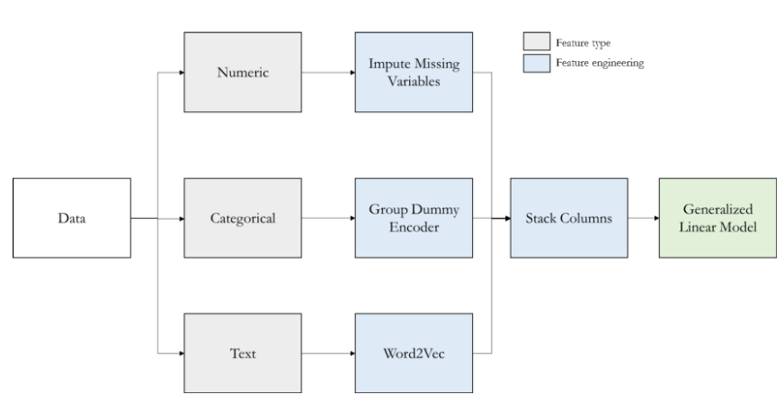
Model Data Transformation – Regressors
Note: Used for Random Forest, LGBM and KNN Regressor Models only
Notes:
This table provides an overview of the data transformation process to run the regression models. As you can see on the grey boxes, we need to work with different types of data. Then the errors point to the blue boxes indicated that we need to use different data engineering methods . The next few slides will provide a breakdown how we get to the final data to run the model.

Slide 10
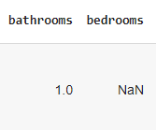


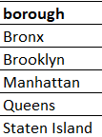
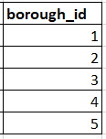

Model Data Transformation - Regressor
1. Imputing Missing Numerical Data
2. Encoding Categorical Data
3. Vectorizing Text Data
Notes:
First we replaced the blank fields with the averages for that specific column
In the next step, we need to put the data like the different boroughs and categorize them in numerical values.
Finally, for the amenities column, we made a vector array counting the amenities features for each listing.

Slide 11
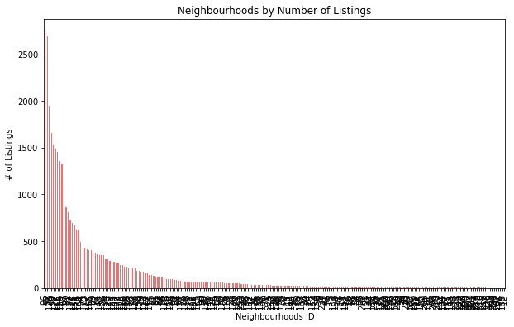
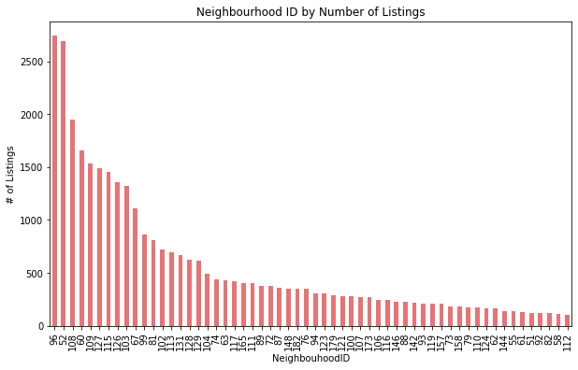
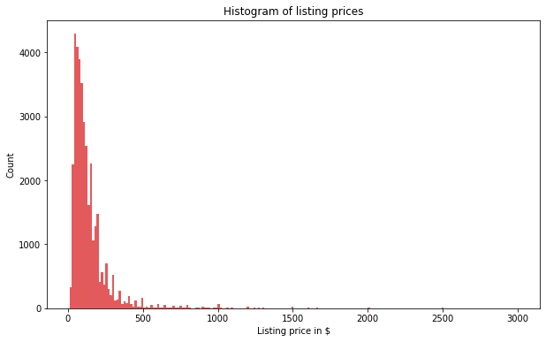
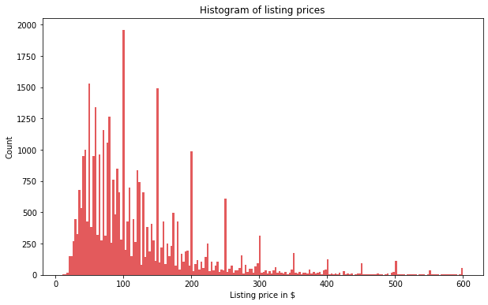
Model Data Transformation - Regressor
4. Removing Outliers
Filter for:
1. ≥100 Listings
2. ≤ $600/night
Notes:
To get the best selection of listings that best represents NYC’s Airbnb market, outliers are filtered out by only keeping the neighbourhoods with over 100 listings & the listing prices that are under $600.
From the right side of the slide, you can tell the data is less skewed.

Slide 12
Model Data Transformation - Prophet
Borough
Room Type
Historical Rates
Holiday Dates
Existing
New
Prophet Model Datasets
Notes:
Another dataset needs to be created because the prophet model runs different then the other regressor models.
We used our existing data get the borough and room type.
Then we went to the inside Airbnb website to get historical rates and the us time and date website to get dates for the public holidays.
Various methods like concatenation, filtering, merging, renaming columns and calculating the mean prices were used in Pandas to get our Final output
We believe that putting all this together can help us accurately predict prices based on location, size, accommodation features, trends and seasonality.

Slide 13

Preprocessing Model Data
RF, LGBM, KNN Regressors
Define features (X-value) that have the most impact on the price (y-value)
Change test data size from 25% to 35% to provide more data to increase accuracy of the models.
Scale the X-values for normalizations to ensure all features are the same unit.
FB Prophet
Group the prices based on borough and room type for the predict future prices.
Notes:
The next step is that we need to select the features that are related to price. We collectively agreed that features like location, room types, # of bedrooms/bathrooms, amenities count review scores, # of reviews are some of the major driving force that impacts what the hosts charge for their Airbnb. Columns like Airbnb listings id are taken out because they do not have any correlation to the price.
Then we increased the dataset size by 10% so that more listing simples can be tested to increase the validity of the test scores.
We must ensure that all x-values are scaled to the same unit so that the model scores are correct.
As for the prophet model, we added the holiday feature, borough and room type info form the original code so that the model can predict the prices based on these criteria.

Slide 14

Running the Model
Fit X and y data in the model.
Determine Coefficient correlation (r^2)
Determine Mean Squared Error (MSE)
Hyperparameter Tune the Model
Notes:
After preprocessing the data, we need to fit the X & y data to run the model. Getting the coefficient correlation score helps us to see how the data fits in the best fit line.
Calculating the mean squared error tells us the squared difference of the actual and predicted values. To improve the test scores, we use hyperparmeter tuning for our models.

Slide 15
Model Results
 | Random Forest (Features) | LGBM (Features) | KNN (Clustering) | FB Prophet (Time)
R² | 53% | 56% | 41% | 84%
MSE | 62.1 | 60.3 | 69.9 | 31.8
R2 = Coefficient of Correlation
MSE = Mean Squared Error
Notes:
After we ran the model, it displays the following results.
The table shows the r squared & mse scores for all models. I have put down which factors the different models look at in brackets.
Looking at the results, KNN has the lowest scores in both the correlation and mean squared error. Probably the model only looks at the price of the closest neighbour.
So besides the location, the hosts will need to look at the room type, amenities, and accommodation features to scale their rates accordingly.
And to earn extra profits, host should detect trends in time and seasonality throughout the year. For example, rates can be priced higher during peak times like weekends, summer months, and on major holidays like Christmas.
The next slide will show the result breakdown of the Airbnb pricing model.

Slide 16
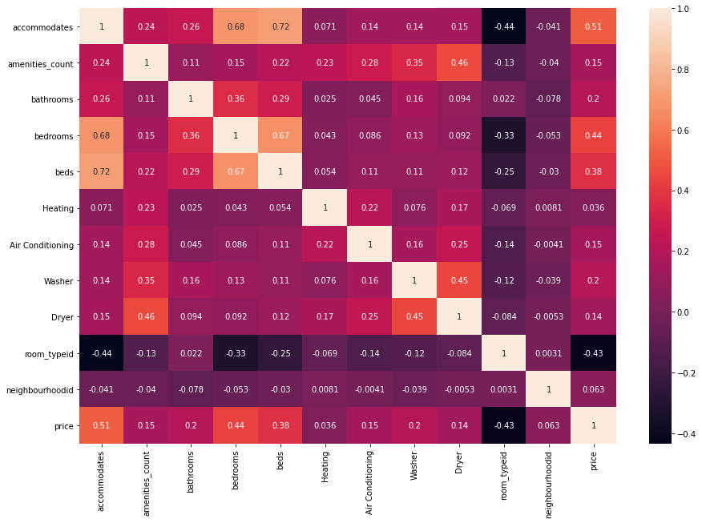
Model Results - Price Correlation
Top 5 Features
Accommodates
Bedrooms
Beds
Bathrooms
Washer
Notes:
In this slide we look at the price correlation versus the accommodations and amenities. the yellow box here shows the price correlation to the accommodations and amenities.
On the right side of the slide, we listed the top 5 features that have the most impact on the price.
Just by looking figures, the heatmap implies that size and basic accommodations have a moderate impact on the prices. Having more amenities like washer and air conditioning are nice to have features that can help increase the rates.

Slide 17
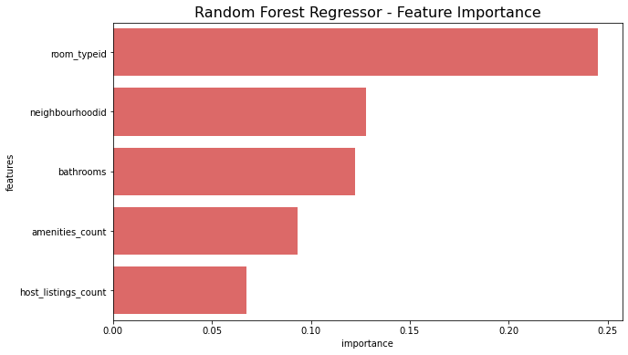
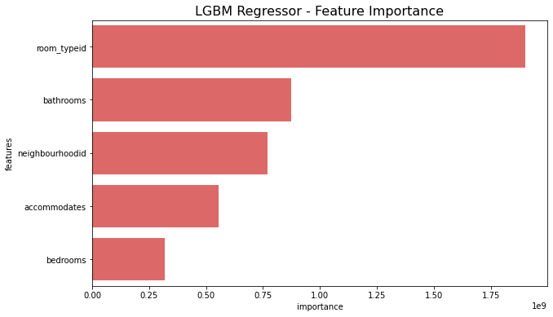
Model Results – Features Importance
Both models have room types, neighbourhoods and bathroom as their most important feature
Notes:
After running the random forest and LGBM Regressor models, we got the 5 most important features.
Both models show that the most important features are room types, the neighbourhood and the # of bathrooms the unit has.
Once again, size & accommodation requirements are the major forces of determining the prices. Another implication from these models tell us that where the listing is located is also very important

Slide 18
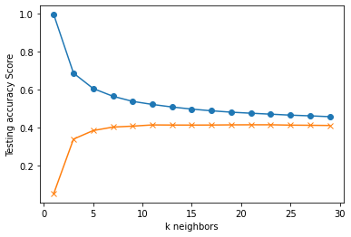
Model Results – Nearest Neighbours
training
testing
Notes:
Since location is one of the stronger components based on the RF & LGBM model, we wanted to use the KNN model to determine how effective it is with averaging the price of your model to your nearest neighbour.
As you can see in this graph, the model score is quite low. This may potentially be since NYC is a large city that offers various units in different room types in one specific area. For example the same street can offer a hotel room and a shared room where the price range differs greatly.

Slide 19
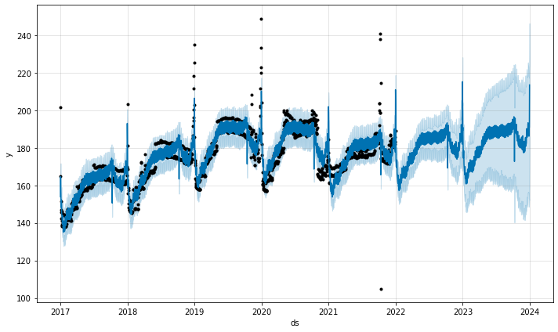
Model Results – Trends
Downward Trend
Upward Trend
Slight Increase
Notes:
We got the following results from the trend predictions from the Prophet Model.
Graph shows the overall actual trends & predictions.. The black dots are the actual average daily prices from our datasets. The dark blue lines are the predicted prices, and the light blue area are the upper & lower limits of the predicted prices.
As you go further in the future, the limits increase as there are more uncertainty factors.
Overall trends of this graphs shows that
there is a cyclical movement throughout the year
Prices has been increasing from 2017 up to the first part of 2020.
Downward trend after the second part of 2020 due to Covid-19.
2021 rates is at the lowest as the economy is greatly impacted by the pandemic.
For 2022-23, it shows a slight increase in the prices based on past trends and incorporate the sudden decrease form Covid-19.

Slide 20
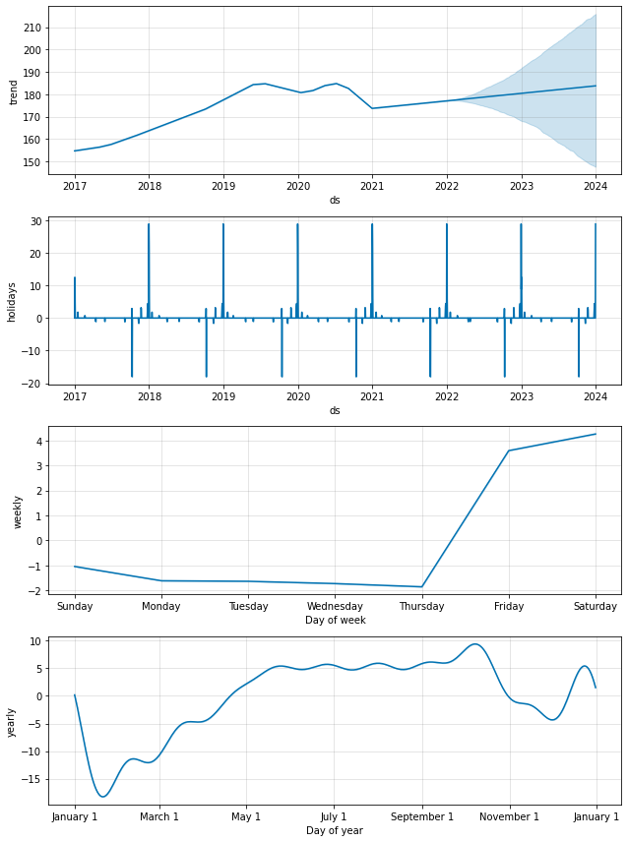
Model Results – Trends & Seasonality
Peak holiday seasons are Christmas, New Years and Long Weekends.
High Demands for Airbnb Rentals on the Weekends.
Summer months tend to have higher rates than winter months.
Notes:
The prophet model here breaks down the rates in different time components by holidays, months and day of week.
On the first chart, it shows that the Christmas breaks and long weekends have the highest impact on rates as people likely take vacations during longer breaks from work and school.
With that being said, the weekly chart indicates the highest rates are on Friday & Saturday which falls into the weekend.
Finally, it shows that the different months of the year have a big impact on the rates. The summer months are predominantly higher likely because the weather is nicer and most families travel when their kids do not have schools for the summer.

Slide 21

Recommendations for NYC Airbnb Hosts
Manhattan and Brooklyn have the higher rates as it is the central part of New York City.
Benchmark against neighbouring units based on room type and size.
Maximize revenue by increasing rates during normal and long weekends, summer months, and holidays like Christmas.
Prices increase by providing more accommodation features like bedrooms & bathrooms.
Providing more amenities provides some help to charge more on the unit.
Unlikely events like the pandemic and terrorist attacks have significant impacts on price decrease.
Notes:
There are many things that a host needs to consider when pricing the unit.
The centrally located like Manhattan and Brooklyn will have one of the higher rates because it is close to the transit system, main attractions, and the business centers. However, the host should not just price their based on this. They can compare with the neighbouring listings based on size instead of just taking the whole average because a hotel room vs a private room can have a huge price range. Also offering different prices during holidays, summer, and long weekends can help the host make the most out of their Airbnb income. Also, there is s a positive correlation on how many people the unit accommodates, the # of bedrooms and bathrooms it offers. Offering more amenities like a washer, heat and A/c provides some help into increasing the listing price. Even though the probability is low, but events like the pandemic & 911 will have a major impact on the whole economy and the demand to travel will decrease.

Slide 22

Project Challenges
Data formats inconsistencies between new and existing datasets.
Large datasets are resource-intensive.
Limited Connections to run the free version of the PostgreSQL.
Requires many trial runs to select the right features to find the best fit for the model.
Time Consuming to run the Hyperparameter Tuning for the test results as many combinations are tested to determine the overall test score.
Notes:
→ Rest of the team to add inputs
Adding new information to our database requires extensive research. After getting the data, we need to transform the data and format the data to be consistent all across so we can load it to the database.
Some of these datasets have millions of rows takes up storage space and slows down the computer speed.
When we connected our free version of Postgresql to Tableau, it reduced our productivity time as not all of us can go to the file at the same time to work on our dashboard.
Another challenge is selecting the right features to run our models, we had to go through numerous columns in the dataset and run the model many times to determine which feature has the highest importance.
Finally, fine tuning our testing results takes up a lot of time and research to see which combination of parameters provide the best results.

Slide 23

Next Steps
Use AWS for the ETL to increase processing time and memory space
Add Neighbourhood Feature in the Prophet Model
Search for special events in New York city to predict Airbnb prices.
Look into customer demographics to see types of units they book.
[Gentrification] → Amaris to provide input
Notes:
Some of the things we can do for the

Slide 24
Dashboard Demo
Notes:
So & so we demo the dashboard

